Slide 1
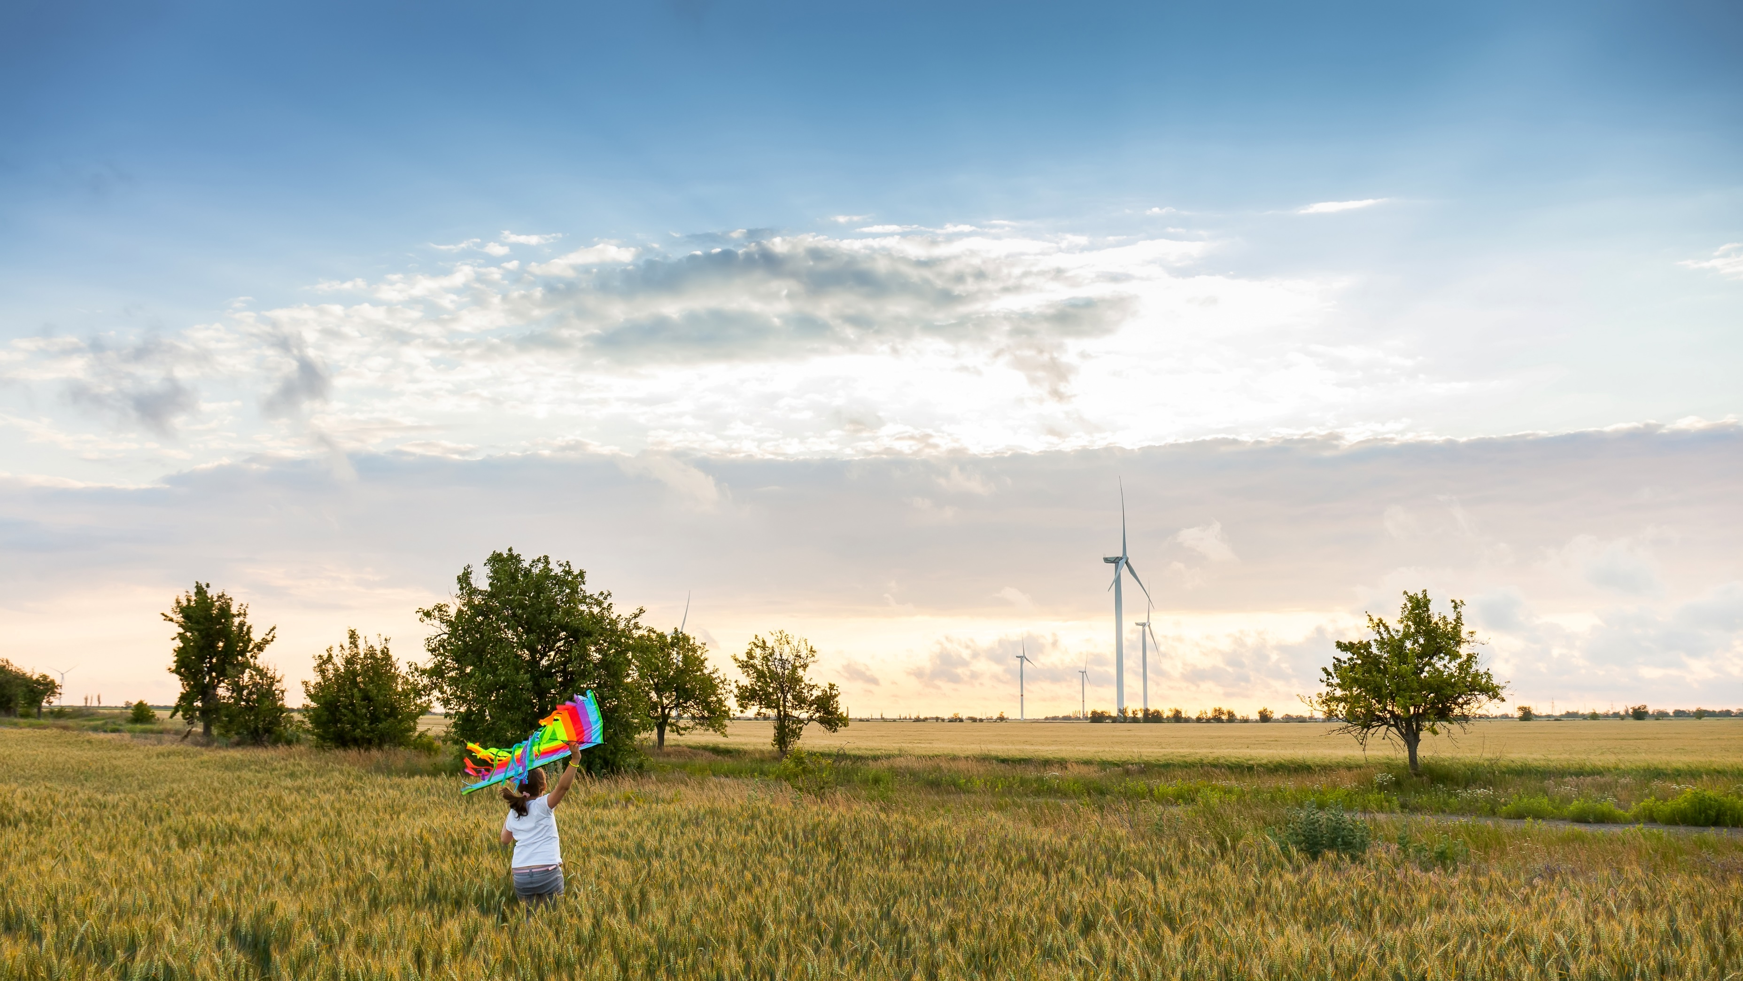


COMMUNITY GEOTHERMAL PLANNING + PILOTS PHASE ONE PLANNING GRANTS WEBINAR
Climate Pollution Reduction Grant Program
December 2025

Slide 2
AGENDA
Illinois Finance Authority, in its role as the Illinois Climate Bank, has secured federal funding for climate finance and to further state goals under the Climate and Equitable Jobs Act of 2021.
Illinois Climate Bank Overview
CPRG Background
Community Geothermal Planning + Pilots Overview
Phase One Planning Grants
Q&A
Next Steps and Resources
Other IFA Resources

Slide 3
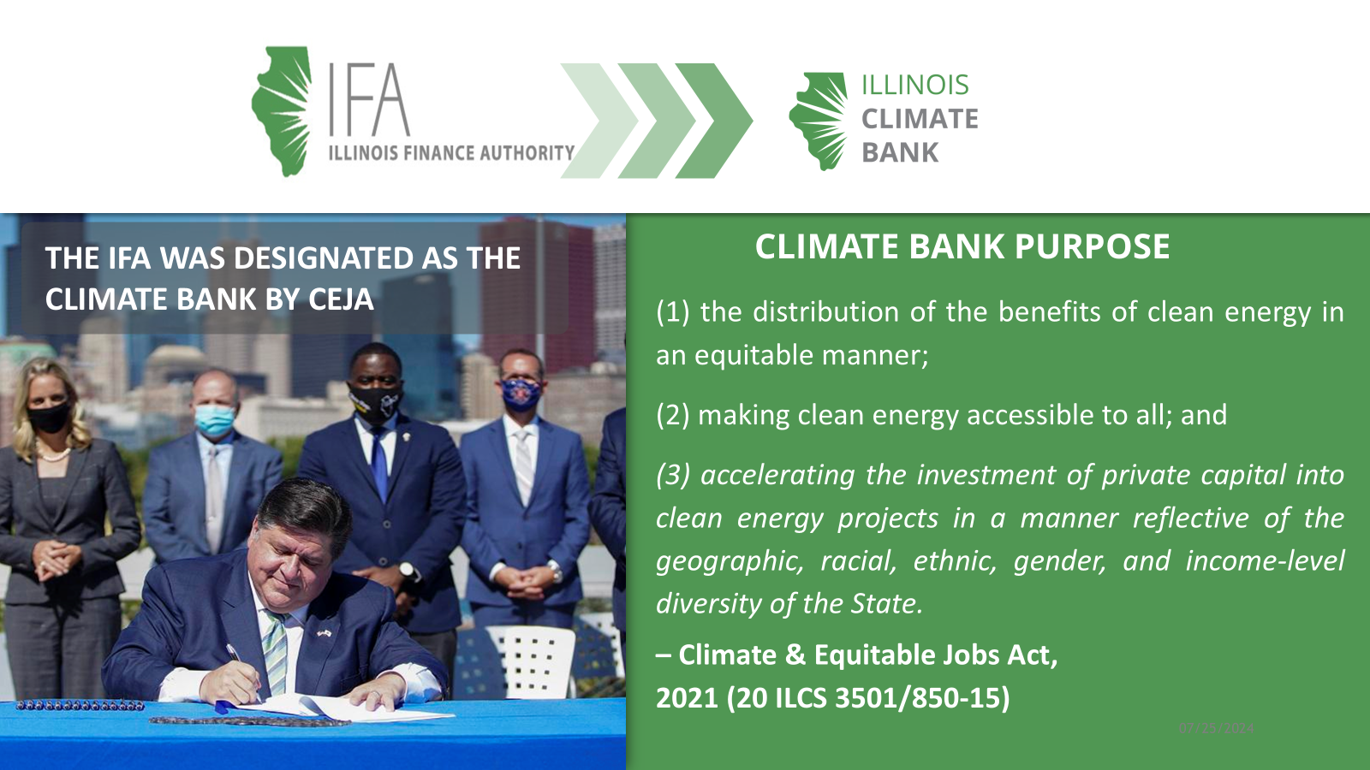

Slide 4
OVERVIEW
Climate Pollution Reduction Grant
In October 2024, U.S. Environmental Protection Agency (US EPA) awarded the state of Illinois, through the Illinois Environmental Protection Agency (IL EPA), $430,000,000 under the Climate Pollution Reduction Grant (CPRG) to implement several initiatives and programs across 5 key sectors. These sectors include buildings, transportation, agriculture, power, and industry.
The Illinois Climate Bank received a subaward of $137,000,000 to implement several initiatives and programs under the CPRG award that aligns with Illinois state policy and CEJA.

Slide 5
OVERVIEW
Community Geothermal
Geothermal heat pump applications rely on the stable, moderate temperature conditions that are found within the subsurface layers of the earth’s crust. Once below the frost line, the temperature within the earth maintains an average temperature around 55-65°F. In geothermal heat pump applications, the thermal energy within the ground is transferred to a heat pump by a series of looped piping filled with a fluid energy exchange medium, most often water or a water-based solution. The heat pump converts this energy to provide heating or cooling in a building.
Community Geothermal deploys this technology at scale, through connection from multiple buildings to a shared geothermal ground loop.

Slide 6
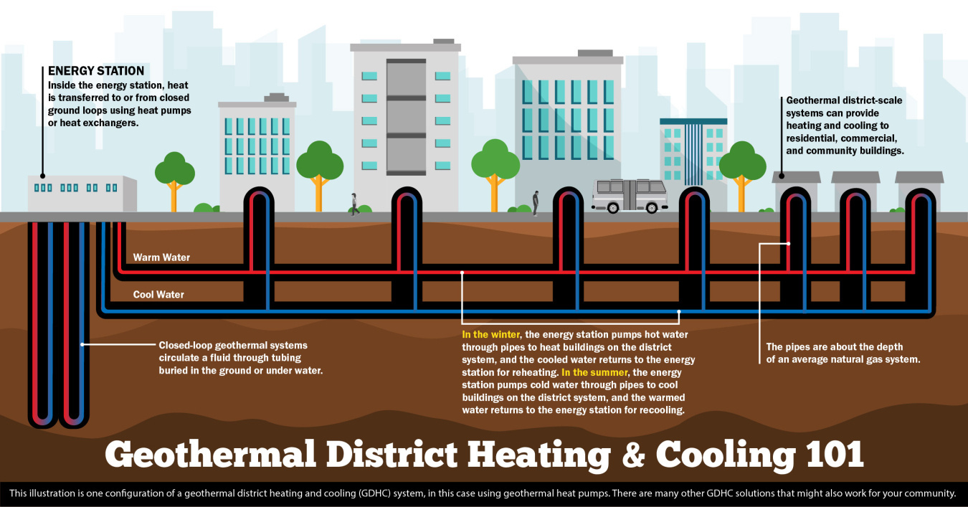
OVERVIEW
Community Geothermal

Slide 7
ILLINOIS FINANCE AUTHORITY | ILLINOIS CLIMATE BANK
COMMUNITY GEOTHERMAL PLANNING + PILOTS
$15 MILLION AVAILABLE
A total of $15 million is available over 4 years
Early-State Planning and Construction
GRANT PROGRAM overview
Two-part process to support early-stage and ready projects
The Community Geothermal Planning + Pilots Program is designed to support the development and deployment of community-scale geothermal systems. As set forth in the CPRG program goals, this initiative aims to:
Reduce carbon pollution by 15,099 metric tons of CO₂ equivalent (mt CO₂e) by 2030,
Achieve cumulative reductions of 128,562 mt CO₂e by 2050, and
Serve 1,100 Illinois households with community geothermal systems by 2030.
TARGET: 1,100 households
The funding is intended to help connect 1,100 Illinois households to community geothermal systems by 2030

Slide 8
Structure and Approach
In November 2025, IFA/ICB launched the Community Geothermal Grant Plan which outlines the program design, project eligibility, and project design criteria. All projects submitted under the NOFOs will be scored based on alignment with the plan and CPRG goals.
Phase 1: Planning Grants Released December 2025 | Engineering and system design, community engagement, financial modeling, permitting support, and other planning activities to align with the key features and requirements of the program. | Up to $250,000 per award Competitive Grants | Applications Due February 13, 2026
Phase 2: Pilot and Project Deployments Winter 2026 and beyond | Construction and deployment of community geothermal projects. | $1,000,000-$5,000,000 Competitive Grants
COMMUNITY GEOTHERMAL PLANNIG + PILOTS OVERVIEW

Slide 9
Phase 1 Planning Grants: Purpose and Intent
Phase 1 grants are designed to support targeted planning work that will culminate in a completed Community Geothermal Project Plan aligned with the Community Geothermal Planning + Pilots Program Plan.
All Phase 1 activities must clearly build toward the scope, scale, and eligibility criteria required for Phase 2 Pilot & Deployment Grants.
Grants are not intended to fund all planning activities.
Competitive applications will demonstrate progress already underway and a clear 12-month path to completing the Project Plan.
Applicants must upload documentation showing work already completed, including feasibility analysis, community engagement, conceptual site work, partnerships, etc.
Using Attachment A & Attachment B, applicants must clearly describe:
  What Phase 1 funds will support
  What activities are funded through other resources
  How the full plan leads to a Phase 2-ready project
COMMUNITY GEOTHERMAL PHASE ONE PLANNING GRANTS

Slide 10
Phase 1 Planning Grants: Community Geothermal Project Plan
At the end of the 12-month grant period, each awardee must submit a completed Community Geothermal Project Plan that includes the following key elements
Scope and Scale. Projects must use geothermal as the primary technology and demonstrate a community-scale design that serves multiple residential or mixed-use buildings across one or more neighborhoods or census blocks.
Community Engagement. Includes a community engagement plan and documentation of engagement activities completed to date, demonstrating alignment with Phase 2 eligibility criteria.
Community-scale design concept. Projects must show a customer base of roughly 100 households or equivalent units and demonstrate that a minimum of 25% of households or customers within the project’s neighborhood or census-block footprint are committed participants or actively engaged in the planning and development process.
Consumer Protections. Includes contracts and recommended disclosures.
COMMUNITY GEOTHERMAL PHASE ONE PLANNING GRANTS
Workforce Development and Contractor Strategy. Includes required PLAs for projects above the applicable threshold and a plan for meeting apprenticeship requirements.
Funding and Financing. Provide 20-year pro-forma financials, show how the project leverages complementary funding sources without double-counting emissions reductions, and clearly describe the ownership structure for the system.
Bill Savings. No increase in total household energy bills.
Engineering, Design, and Feasibility. Includes mechanical and civil drawings, technical engineering reports, permitting and environmental plans, square footage and building-type details, and system Coefficient of Performance (COP).
Compliance Strategy. Provides a clear plan for complying with applicable federal and state requirements.

Slide 11
Phase 1 Planning Grants: Eligible & Ineligible Activities
Eligible Activities
Ineligible Activities
Engineering + design
Community engagement
Feasibility studies
Financial modeling
Environmental + permitting planning
Workforce planning
Consumer protections
Ownership structuring
Business model strategy
Partnership development
Other planning related activities
Construction
Equipment Purchases
System Installation
Planning work unrelated to a Phase 2 community geothermal system
Projects located outside of Illinois
Other activities outlined in the NOFO
COMMUNITY GEOTHERMAL PHASE ONE PLANNING GRANTS

Slide 12
Phase 1 Planning Grants: Competitive Proposals
Competitive Proposals will:
Demonstrate meaningful work already underway, supported by documentation uploaded with the application.
Clearly articulate a community-driven approach aligned with the Community Geothermal Planning + Pilots Program Plan.
Present a realistic 12-month plan for completing the Community Geothermal Project Plan.
Show clear alignment with Phase 2 requirements for scope, scale, and project readiness.
Distinguish Phase 1-funded tasks from those supported by other funding sources, showing a complete pathway to Phase 2 readiness.
Attachment A and Attachment B will play a critical role in Phase 1 evaluations. Projects will be assessed based on how clearly these documents communicate a complete and viable plan.
Attachment A: Applicant Information and Qualifications, Project Alignment and Progress to Date, Proposed Use of Funding and Remaining Tasks
Attachment B: 12-month Milestones and Deliverables
COMMUNITY GEOTHERMAL PHASE ONE PLANNING GRANTS

Slide 13

Q&A

Slide 14
Next Steps and Resources
Community Geothermal Planning + Pilots Phase One Planning Grant applications are due February 13, 2026.
The presentation and Q&A from today’s webinar will be posted on the Climate Bank website: https://illinois-climate-bank.web.app/financing-programs/local-governments-nonprofits/community-geothermal-planning-pilots/
If you have further questions, please send them to climatebank@il-fa.com by the date that questions are closing, listed in the program NOFO.
Resources:
Community Geothermal Grant Plan
Phase One Planning Grant NOFO
NOFO Attachment A
NOFO Attachment B
PHASE ONE PLANNING GRANT NOFO NEXT STEPS AND RESOURCES

Slide 15
Other IFA Resources
The Illinois Climate Bank currently has two other open competitive grant solicitations under CPRG; each aligned with Illinois’ climate and equity goals. Both solicitations are open, subject to availability of funds.
Grant Opportunity Name | Funding Source | Estimated Total Current Program Funding | Award Range | NOFO Posted Date | Application Due Date | Eligible Applicants
Stretch Code Adoption Grants | CPRG | $3,200,000 | Up to $200,000 per award | July 15, 2025 | December 31, 2025 | Municipalities
Small Utility Clean Energy Planning | CPRG | $400,000 | Up to $200,000 per award | July 16, 2025 | December 31, 2025 | Municipal and cooperative electric utilities
OTHER IFA RESOURCES

