Slide 1




Stretch Building Code
Adoption Webinar
April 6, 2026

Slide 2





INTRODUCTIONS
INTRODUCTIONS
John Gossman
Technical Manager, Emerging Building Technologies & Building Codes
MEEA
Emma Hurbanis
Associate, Building Codes & Policy
MEEA
Dan Streit
Senior Researcher
Slipstream
Claire Brinley
VP of Climate Bank Programs
Illinois Finance Authority
Andrew Barbeau
Climate Infrastructure Group

Slide 3
AGENDA
Illinois Climate Bank Overview
About the Illinois Stretch Energy Code
Stretch Building Code Adoption Grant Opportunity
MEEA Technical Support
Q&A
Additional IFA Resources
AGENDA

Slide 4


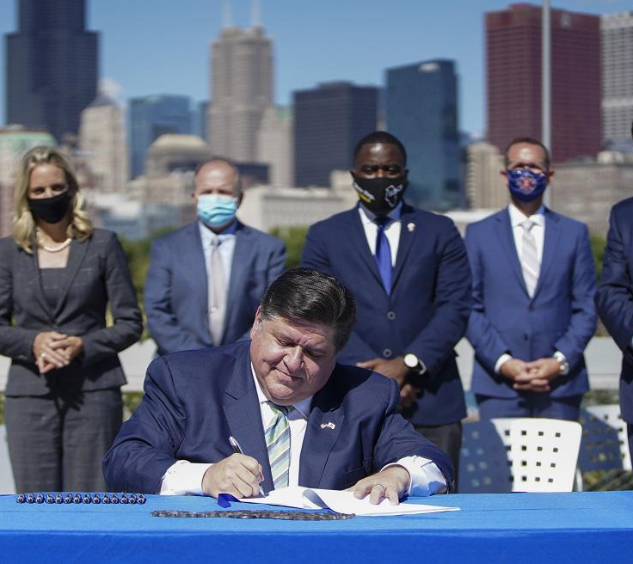
THE IFA WAS DESIGNATED AS THE CLIMATE BANK BY CEJA
CLIMATE BANK PURPOSE
(1) The distribution of the benefits of clean energy in an equitable manner;
(2) Making clean energy accessible to all; and
(3) Accelerating the investment of private capital into clean energy projects in a manner reflective of the geographic, racial, ethnic, gender, and income-level diversity of the State.
- Climate & Equitable Jobs Act,
2021 (20 ILCS 3501/850-15)

Slide 5
Illinois Stretch Building Code

Slide 6
Illinois Stretch Building Code Adoption Grant: Round 3

Slide 7
OVERVIEW
Climate Pollution Reduction Grant
In October 2024, the US Environmental Protection Agency awarded the state of Illinois, through the Illinois EPA, $430M under the Climate Pollution Reduction Grant (CPRG) to implement several initiatives and programs across 5 key sectors. These sectors include buildings, transportation, agriculture, power, and industry.
The Illinois Climate Bank received a subaward of $137M to implement several initiatives and programs under the CPRG award that aligns with Illinois state policy and CEJA.

Slide 8
Stretch Code Adoption Grants: Program Snapshot
Grant Opportunity Name | Grant Type | Eligible Entities | Estimated Total Program Funding | Award Range | Anticipated Number of Awards | Current Application Due Date | Cost Match Requirements
Stretch Code Adoption Grants | Competitive Grant | Municipalities | $18M over five years | Up to $200,000 per award | Dozens | April 30, 2026 | None
STRECH CODE ADOPTION GRANTS
Notes:
Through sept 2029
Competitive

Slide 9
Stretch Code Adoption Grants: Program Purpose
The Stretch Building Code Grant Program provides financial support for municipalities to adopt, implement, and enforce the Illinois Stretch Energy Code. Funding supports education, community engagement, and technical assistance to help municipalities integrate the stretch code into their regulatory frameworks.
Eligible applicants are municipalities defined under the Energy Efficient Building Act (20 ILCS 3125/1) as any city, village, or incorporated town.
STRECH CODE ADOPTION GRANTS

Slide 10
Stretch Code Adoption Grants: Objectives
Municipal Awareness & Capacity Building
Community Engagement & Education
Incremental Code Modernization
Emissions Reductions & Energy Efficiency
STRECH CODE ADOPTION GRANTS

Slide 11
Stretch Code Adoption Grants: Eligible and Non-eligible Activities include, but are not limited to, the following:
Eligible Activities
Staff time for education, training, and capacity building
Municipal leadership and City Council education
Community outreach and public engagement
Hiring external consultants or organizations
Staged code modernization and incremental base code updates
Technical assistance for code compliance and implementation
Contractor and industry professional training
Cost-benefit analysis to support stretch code adoption
Non-Eligible Activities
Activities unrelated to stretch code adoption/implementation, or base code updates where applicable
Equipment purchases or rental
Lobbying activities or union organizing
STRECH CODE ADOPTION GRANTS
See NOFO for additional eligible and non-eligible activities: https://illinoisclimatebank.com/wp-content/uploads/cprg-07-nofo.pdf
Notes:
Not an exhaustive list
Included but not limited to
Construction related activities not eligible

Slide 12
MEEA Technical Support

Slide 13
Q&A

Slide 14
            Contact for Further Questions
This presentation and questions and answers from today’s webinar will be posted on the Climate Bank’s website:
Illinois Climate Pollution Reduction Grants: https://illinoisclimatebank.com/financing-programs/local-governments-nonprofits/stretch-building-code-adoption-support/
If you have further questions, please send them to ClimateBank@IL-FA.com by the date that questions are closing, listed in the program NOFO.

Slide 15
Other IFA Resources
Private Activity Bonds
IFA issues tax-exempt qualified private activity bonds for 501(c)(3) organizations and other conduit borrowers. Borrowers work with banks, underwriters, or placement agents of their own choosing.
State Small Business Credit Initiative
IFA provides low-cost financing to small businesses for eligible climate-related projects.
Commercial Property Assessed Clean Energy Bonds
IFA has statewide authorization to issue bonds and notes to fund eligible building improvements in any PACE area. Eligible improvements include energy efficiency, renewable energy, water use, and EV charging stations. Projects located in Cook County are not currently eligible.
Energy Efficiency Revolving Loan Fund
IFA offers low-interest loans for energy efficiency improvements to commercial or multi-family buildings. Buildings must have undergone an energy audit or assessment.

